Slide 1
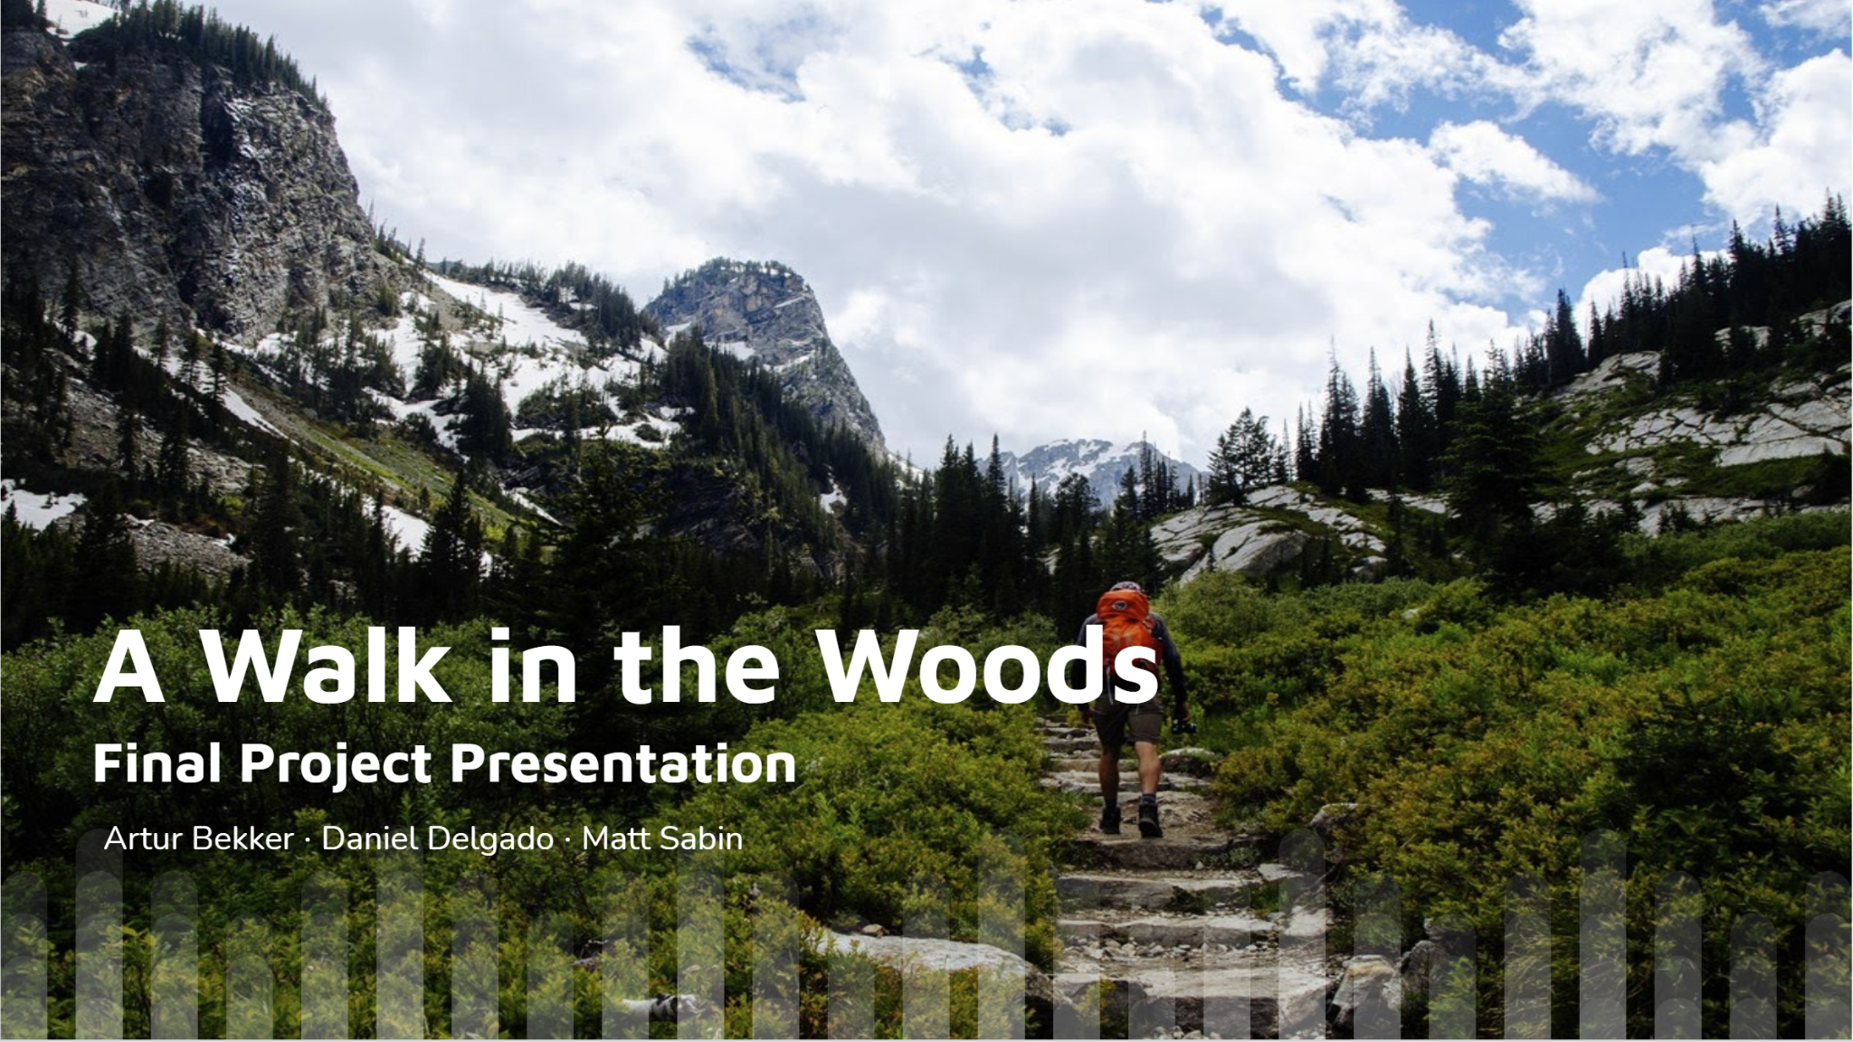

Slide 2
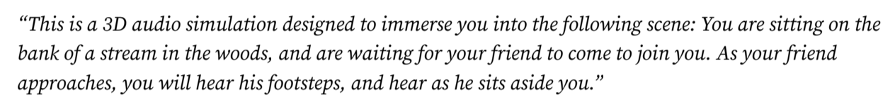
User Study Progress
Our user study focused on effective implementation of sound localization. Users were presented a sample audio using sounds that will be found within our final product, and asked questions about what direction they heard specific sounds from.
Five participants were surveyed, and all five were able to effectively determine the direction from which each prominent sound was played.
The prompt was given to each participant, providing context for the scene in which the audio takes place:

Slide 3
Companies and Institutions that may potentially be interested
Hiking and Trekking Tour Companies would have significant reason to be interested in our application. They could allow users to sample the experience they would have embarking on a trip of their choice through an immersive audio experience. They could also opt to add a visual aspect as well to enhance the immersion.
Some companies that may be interested are
Bamba Travel Adventures (https://bambatravel.com/)
Wildland Trekking (https://wildlandtrekking.com/)

Slide 4
Addition to Already Existing System
Currently, if one wants to go “hiking” without going outdoors their only option is to watch Youtube videos of users doing nature walks. However, this is a very basic way of experiencing nature virtually. Our program improves this in several significant ways.
Users can reach forks in the road, and choose which path they would like to go on. This adds to immersion and gives the user some freedom of choice rather than having them on rails.
The sound users hear are all processed to be 3D audio, so the users will hear noises that appear from different sides of their heads, making the audio experience much more realistic.
Since our program is a virtual environment rather than a video where one is walking through actual wilderness, users can travel through different biomes quicker than they would change in real life, allowing for a more fun and varied experience.

Slide 5
Our Future Steps
Given another semester to continue to work on this project, we would mainly focus on expanding the scope of the program. Things we would like to do are
Increase the size of the map
Add an additional biome
Allow functionality for the user to move backwards on the trail
Create an option for users to hear a tour guide with a relaxing voice

Slide 6
“Sky is the Limit” Steps
Given infinite time and resources to continue work on this project, we would like to greatly increase the replayability of this program. Some things we would want to add are
Randomized animal noises, with occasional rare animal encounters
Additional maps for users to choose from
“Fun Biomes” with unique noises such as an alien planet
An enhanced visual interface, with potential compatibility with Virtual Reality headsets such as the HTC Vive.

Slide 7
Challenges Faced
Anticipated Challenges - Two of our three group members had no experience programming in Python, so we knew we would have to educate ourselves on how to code in the language for this project.
Unanticipated Challenges - An unanticipated challenge we faced was not owning a version of Matlab compatible with Python. We created audio files in Matlab and planned to have them play through Python, but the UFapps version of Matlab did not have this functionality. Therefore, a group member had to purchase a special Matlab student license.

Slide 8
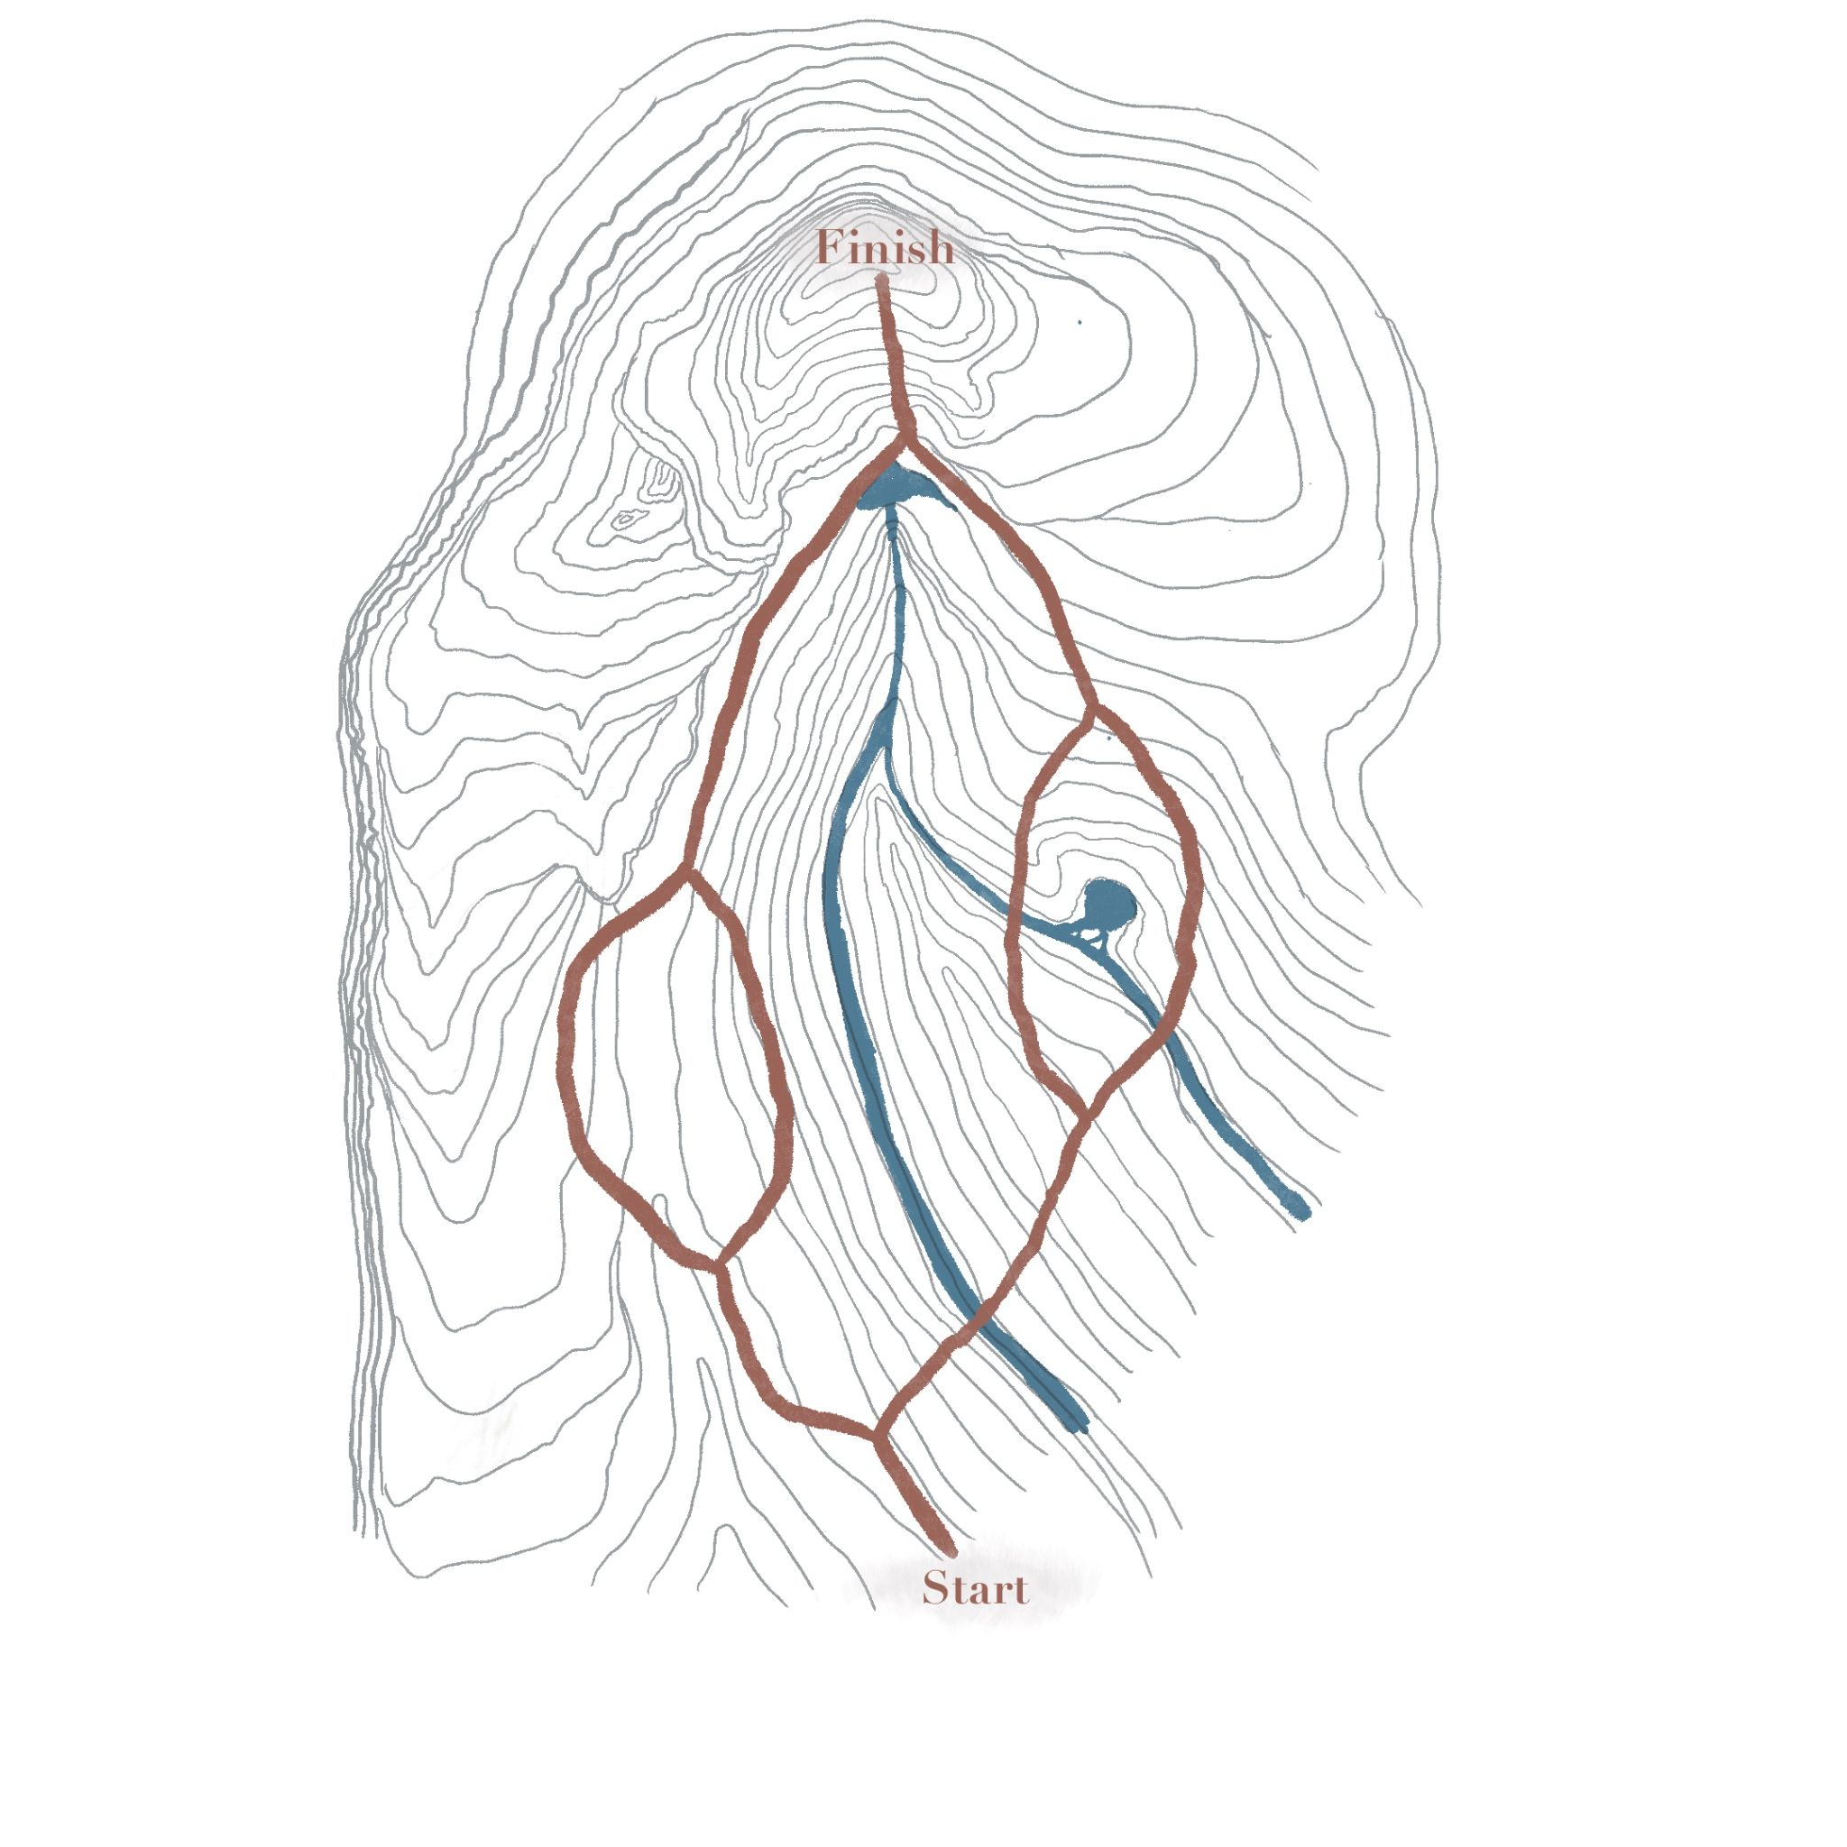
Development Progress
At this stage in development, about half of our 3D audio has been generated, and assigned to a certain trail within our map. As the user progresses through the trails and decides their chosen path, they will experience different audio than other users. In total, there will be four unique trails for users to experience, each taking about 10 minutes to hike.
Topographic map that the user will hike through.

Slide 9
Project Demo
https://drive.google.com/file/d/1UVx-N_NTeONjVW77FbWRIIHd9AWY6w-C/view?usp=sharing

